Slide 1
What is UI Automation
Thach Hoang
Jul21, 2021

Slide 2
Test Automation Tools/FWs
Common UI testing tools
Headless/Headed Browser
Mobile Automation Approaches
Locator Strategy
Distributed Testing
Visual Validation
UI testing challenges
Reporting
Agenda

Slide 3
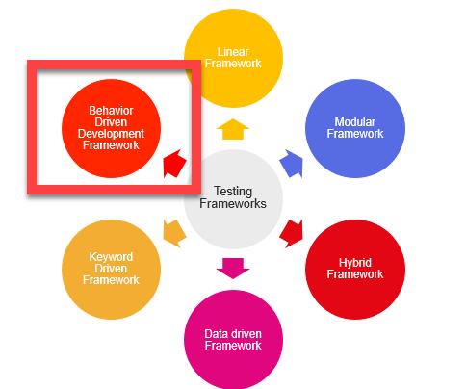
Test Automation Frameworks
Notes:
A framework defines a set of rules or best practices which we can follow in a systematic way to achieve the desired results. So the above-mentioned test automation frameworks deal with best practices to achieve the goals of our automation project.
Linear scripting
In the modular testing framework, testers create test scripts on module wise by breaking down the complete application under test into smaller, independent tests.
Data-driven test automation framework is focused on separating the test scripts logic and the test data from each other. Allows us to create test automation scripts by passing different sets of test data
In Keyword-driven testing, we use a table format to define keywords or action words for each function or method that we would execute. It performs automation test scripts based on the keywords specified in the excel sheet.
Hybrid Test automation framework is the combination of two or more frameworks mentioned above. It attempts to leverage the strengths and benefits of other frameworks for the particular test environment it manages

Slide 4
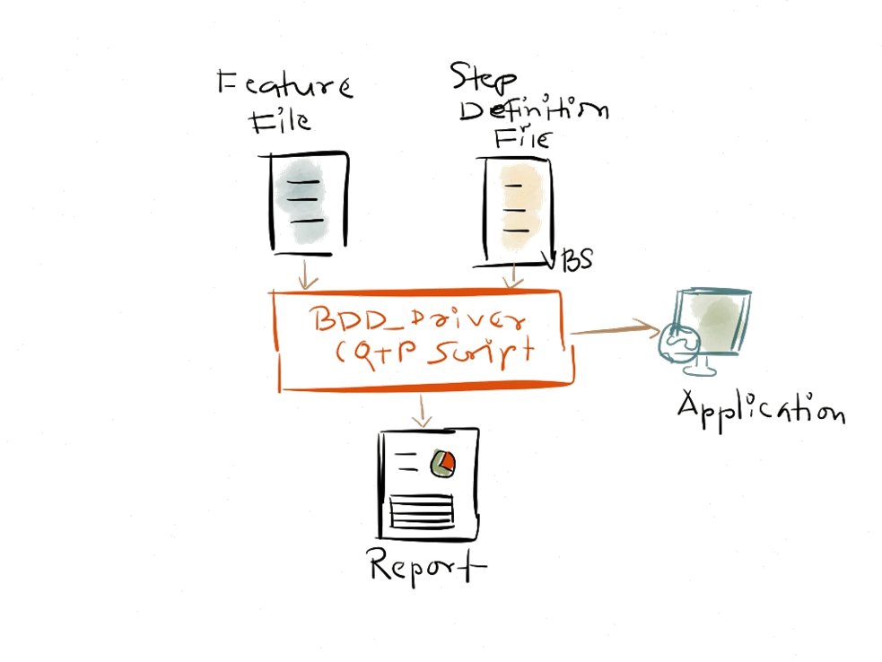
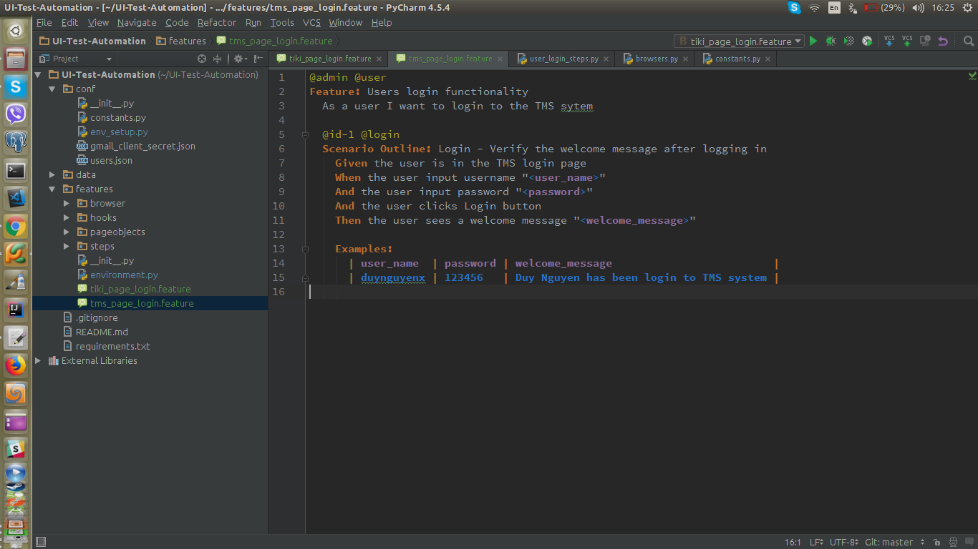
BDD Automation Framework
BDD Framework
Notes:
http://www.softwaretestinghelp.com/test-automation-frameworks-selenium-tutorial-20/
4

Slide 5
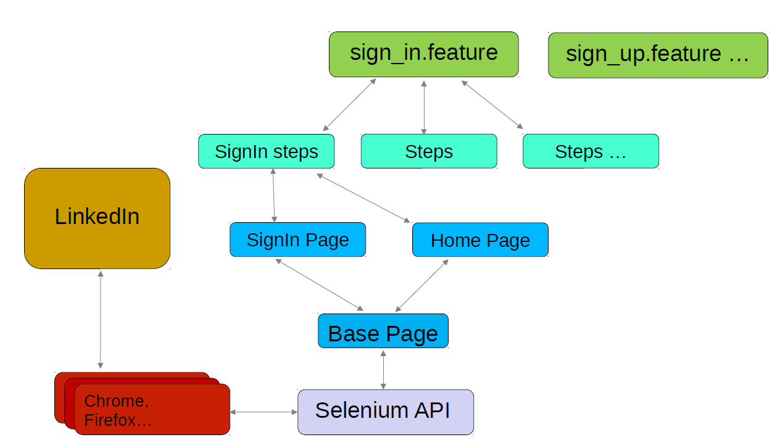
POM with BDD
Notes:
5

Slide 6
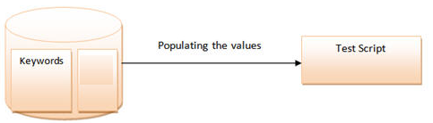
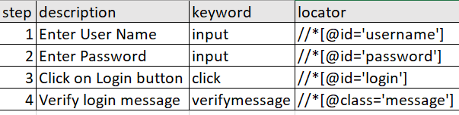
Keyword Driven Framework
Keyword Driven Framework

Slide 7
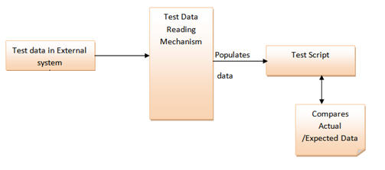
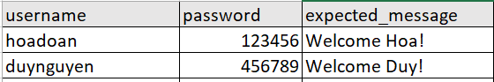
Data Driven Framework
Data Driven Framework
Notes:
External System: xml files, excel files, text files, CSV files, ODBC repositories

Slide 8
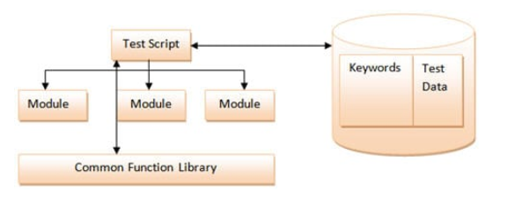
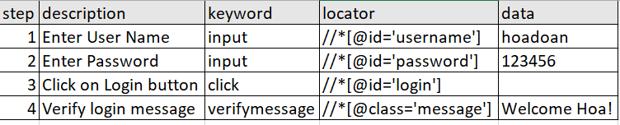
Hybrid Driven Framework
Hybrid Driven Framework

Slide 9
Common UI Test Automation Tools

Slide 10

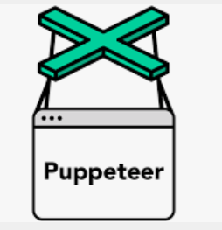







Common UI Test Automation Tools
Notes:
https://blog.checklyhq.com/puppeteer-vs-selenium-vs-playwright-speed-comparison/
https://blog.checklyhq.com/cypress-vs-selenium-vs-playwright-vs-puppeteer-speed-comparison/
https://www.testim.io/blog/puppeteer-selenium-playwright-cypress-how-to-choose/

Slide 11
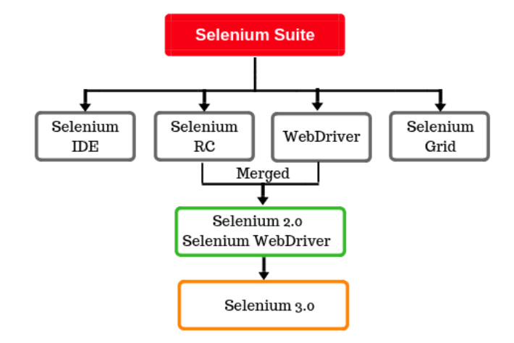
History of Selenium
Notes:
https://www.selenium.dev/history/
1. Selenium was originally developed by Jason Huggins in 2004 as an internal tool (JavaScriptTestRunner) at ThoughtWorks
2. Paul Hammant joined the team and steered the development of the second mode of operation that would later become "Selenium Remote Control" (RC). The tool was open sourced that year.
3. In 2007 Simon Stewart at ThoughtWorks developed a superior browser automation tool called WebDriver
4. In 2009 → merge two projects called Selenium WebDriver
5. 2008 Philippe Hanrigou (then at ThoughtWorks) made "Selenium Grid“which provides a hub allowing the running of multiple Selenium tests concurrently on any number of local or remote systems, thus minimizing test execution time
Same-Origin Policy (SOP) là một phần quan trọng trong hệ thống bảo mật của trình duyệt nhằm ngăn chặn những trang web độc hại truy xuất được các thông tin bí mật của những trang web khác. Ví dụ thepriatebay.com không thể truy xuất dữ liệu từ trang Barclays.com vì nó bị chặn bởi SOP
Phương thức hoạt động rất đơn giản, đó là những trang web khác trang web gốc có thể gửi requests đến những domains khác nhưng không nhận được responses trả về
Một điều cần chú ý là SOP không ngăn chặn việc khởi tạo và gửi các REQUEST và cũng không ngăn chặn phía Server sẽ không thực thi các REQUEST này, nhưng trình duyệt sẽ giúp ngăn chặn thực thi các RESPONES từ phía SERVER trả về.
Tuy nhiên một vài REQUEST lại không cần phải thực thi RESPONSE, và lợi dụng điều đó kẻ tấn công vẫn thực hiện được ý đồ của mình – Đây là loại tấn công Cross-Origin Request Forgery (CSRF).

Slide 12
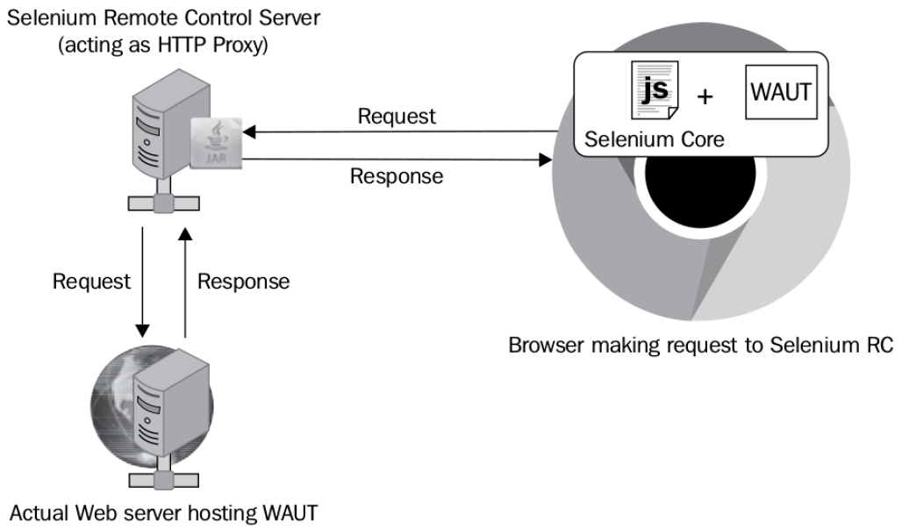
Selenium RC
Notes:
The requests and responses of the browser for WAUT go to the actual web server via Selenium RC
Server
Limitation of Selenium RC:
- Core being limited within the JavaScript sandbox of the browser, as it
needs to comply with the Same-Origin policy.
- Because this JavaScript library is generic and not specific to any particular
browser, the developers of test scripts sometimes end up with a situation
where their test scripts execute very well on some browsers but not on
some other.

Slide 13
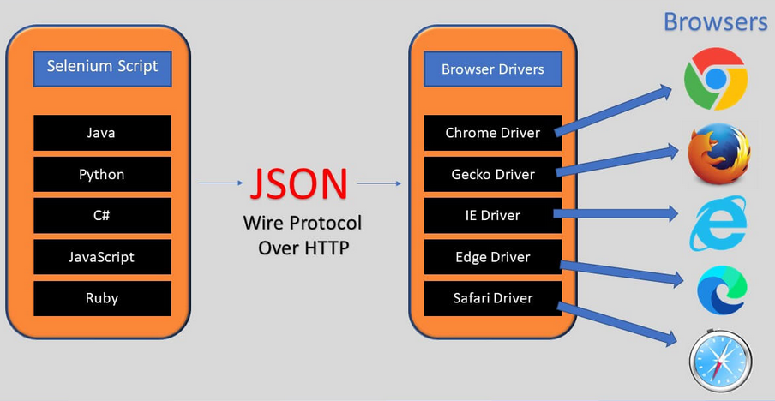
Selenium WebDriver (JSON Wire protocol)
Notes:
This wire protocol defines a RESTful web service using JSON over HTTP.
WebDriver can handle Selenium RC problems:
- Giving a better control on the browser by implementing browser-specific
implementations.
- Giving a better programming experience to the developer by adhering
more closely to the object-oriented programming fundamentals.

Slide 14
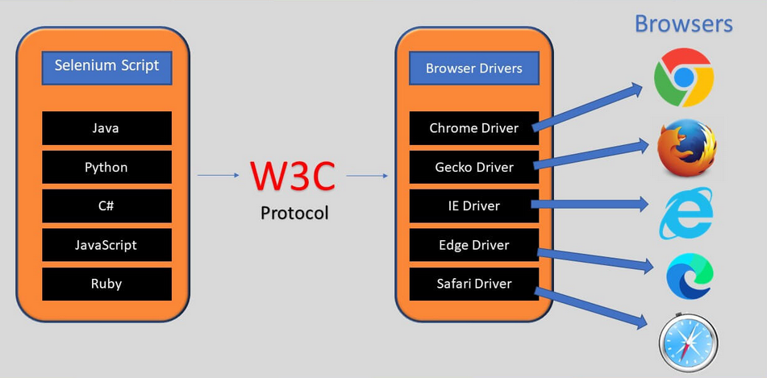
Selenium WebDriver (W3C protocol)
Notes:
https://www.qafox.com/selenium-4-w3c-standardization/
https://w3c.github.io/webdriver/

Slide 15
Json wire - Find Element
driver.find_element(By.CSS_SELECTOR, 'input#email_create ')
Command.FIND_ELEMENT: ('POST', '/session/$sessionId/element')
Request data
{"value": "input#email_create", "using": "css selector", "sessionId": "f814e98e23e15bcf189169f55913b24f"}
Endpoint
http://127.0.0.1:54444/session/f814e98e23e15bcf189169f55913b24f/element
Response
{'status': 0, 'sessionId': 'f814e98e23e15bcf189169f55913b24f', 'value': {'ELEMENT': '0.01957607025525676-1'}}
Notes:
from selenium.webdriver.common.by import By

Slide 16
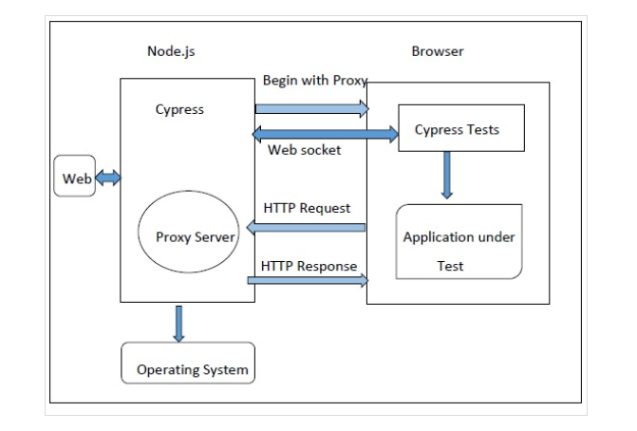
Cypress Architecture

Slide 17
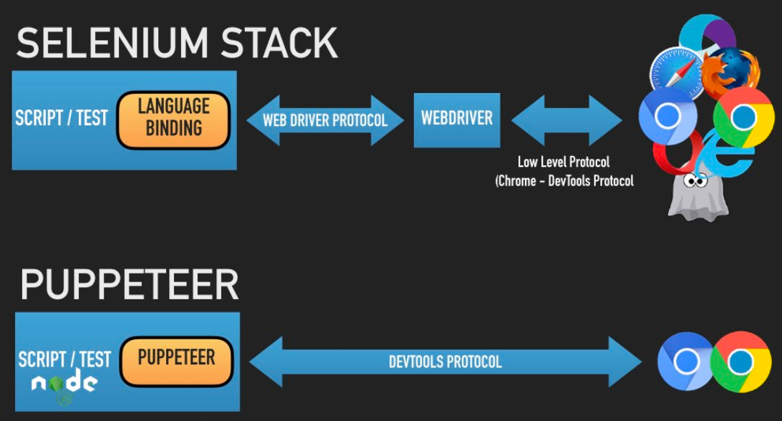
Pupperteer/Playwright Architecture

Slide 18
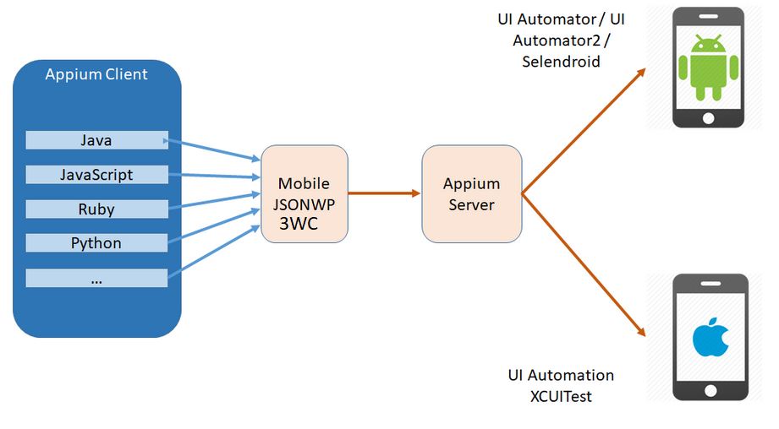
Appium Architecture

Slide 19
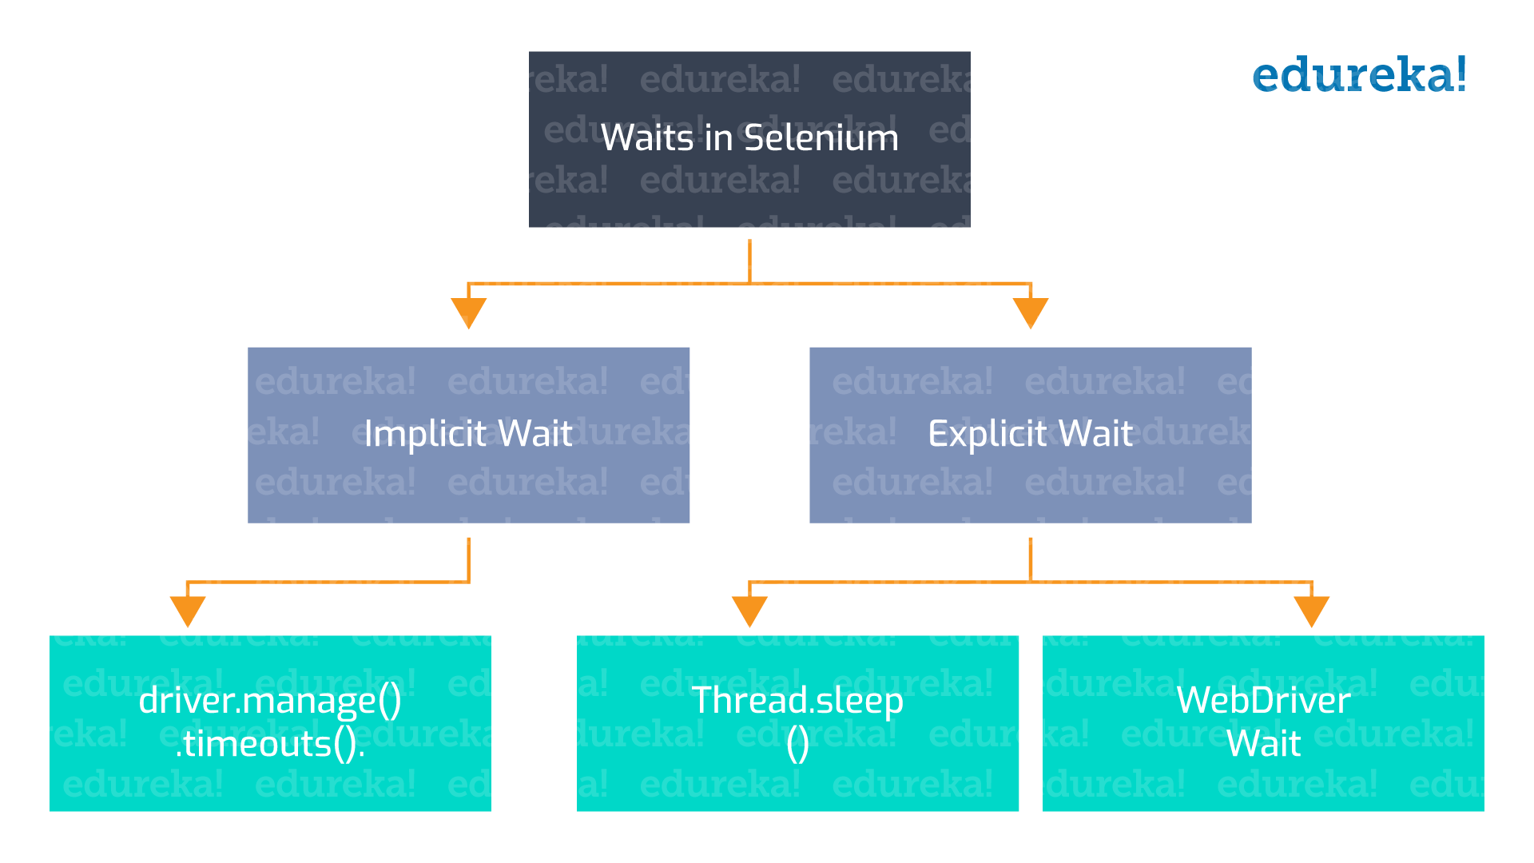
Selenium Waits
Notes:
These days most of the web apps are using AJAX techniques. When a page is loaded by the browser, the elements within that page may load at different time intervals. This makes locating elements difficult: if an element is not yet present in the DOM, a locate function will raise an ElementNotVisibleException exception. Using waits, we can solve this issue.
Explicit Wait
This waits up to 10 seconds before throwing a TimeoutException unless it finds the element to return within 10 seconds. WebDriverWait by default calls the ExpectedCondition every 500 milliseconds until it returns successfully
Implicit Wait
By implicitly waiting, WebDriver polls the DOM for a certain duration when trying to find any element. This can be useful when certain elements on the webpage are not available immediately and need some time to load.
The default setting is 0. Once set, the implicit wait is set for the life of the WebDriver object, session.
Warning: Do not mix implicit and explicit waits. Doing so can cause unpredictable wait times. For example, setting an implicit wait of 10 seconds and an explicit wait of 15 seconds could cause a timeout to occur after 20 seconds.

Slide 20
Locator/Selector Strategy

Slide 21
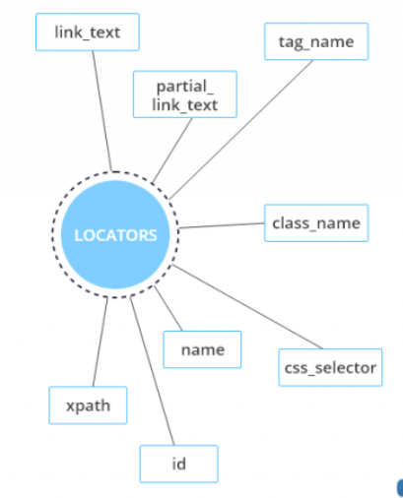
Locator/Selector Strategy
Unique
Reliable
Performance
ID >> Name >> CSS >> XPATH
Notes:
What are web elements?
https://browsee.io/blog/strategies-to-handle-dynamic-web-elements-in-selenium/
http://appium.io/docs/en/commands/element/find-elements/index.html#selector-strategies
https://medium.com/@kshitishirke/which-locator-is-faster-in-identifying-elements-in-selenium-5aeb3f943f5d
https://www.linkedin.com/pulse/which-selenium-webdriver-locator-faster-zhimin-zhan-1c/

Slide 22
Locator/Selector Strategy
Short, Descriptive and Unique
ID >> name >> others (css, xpath, link text, class)
Avoid Absolute XPath
/html[1]/body[1]/nav[1]/div[1]/form[1]/div[1]/div[1]/div[1]/artdeco-typeahead-deprecated[1]/artdeco-typeahead-deprecated-input[1]/input[1]
Do not use dynamic attribute
Use Multiple attributes to locate an element (css, xpath)
//button[starts-with(@id, 'save') and contains(@class,'publish')]
Avoid using wildcard, index number in XPath locator
Ask FE developers to add customized attribute for automation tests. e.g. data-test, data-test-id

Slide 23
Mobile Testing Approaches

Slide 24

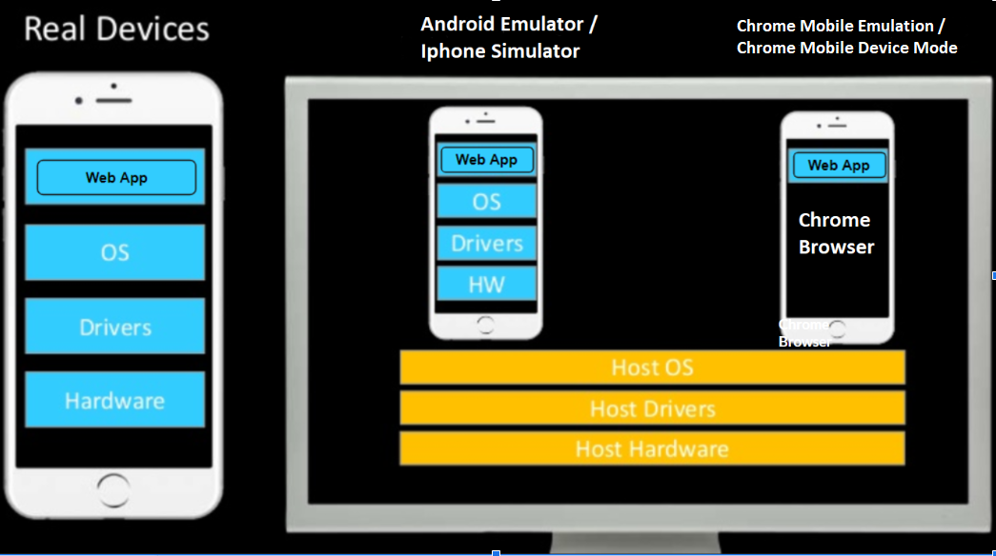
Mobile Testing Approaches
Chrome Browser

Slide 25
1st Option: Chrome Mobile Emulation
PROS | CONS
price | reliable
faster and with less latency | Missing address box (different height)
access to detailed information such as debugging information | Hardware and Software Differences
simulating hard-to reproduce scenarios (GPS coordinates, network condition) | Different Network Environment
Faster developing auto tests | Differences in Computing Resources
Faster feedback (+ parallel execution)

Slide 26
2nd Option: Android Emulator/Iphone Simulator
PROS | CONS
price | reliable
access to detailed information such as debugging information | Hardware and Software Differences
simulating hard-to reproduce scenarios (low battery, GPS coordinates, network) | Different Network Environment
 | Differences in Computing Resources
Notes:
https://www.browserstack.com/guide/testing-on-emulators-simulators-real-devices-comparison

Slide 27
3rd Option: Real Devices
PROS | CONS
Truly user experience | procuring and managing Costs
Reliability | debugging
expose performance defects | simulating hard-to reproduce scenarios (low battery, GPS coordinates, etc.)

Slide 28
Headless Browser

Slide 29
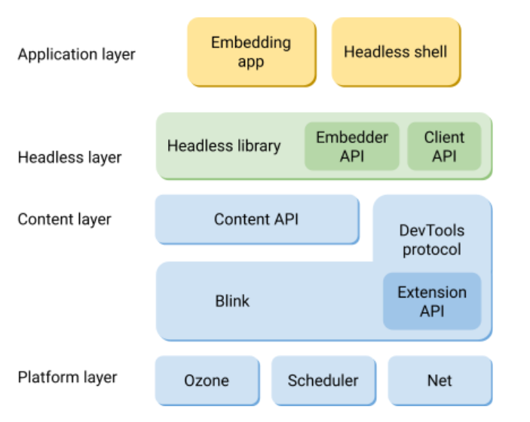
What is Headless Browser
web browser without GUI
Chrome Headless Architecture
Notes:
https://en.wikipedia.org/wiki/Headless_browser
https://testguild.com/headless-browser-testing-pros-cons/
https://stepupautomation.wordpress.com/2021/04/30/what-is-headless-browser-and-how-to-utilize-it-for-automation-testing/

Slide 30
Headless Browser
Benefits of Headless Browser
Greater testing reach: allow to run UI tests on non-GUI environment like Docker, linux.
Improved speed and performance: test run faster and consume less resources (CPU, memory)
Multitasking: With the UI disabled, headless testing lets you continue to use your computer while the tests execute in the background.
Disadvantages Of Headless Browser
Hard for debugging as you do not see what happen on the browser
Not a real browser, not mimic the real user interactions

Slide 31
Distributed UI Testing Solutions

Slide 32
Distributed UI Testing Solutions
Selenium Grid
Cloud-Based Cross Browser Testing
SauceLabs
BrowserStack
…

Slide 33
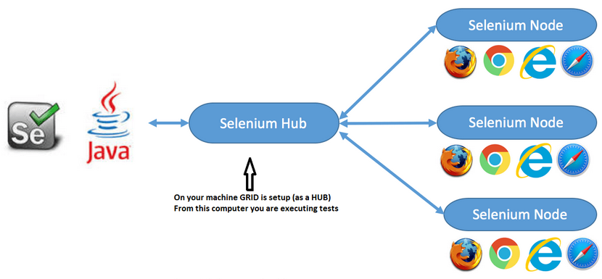
Selenium Grid

Slide 34
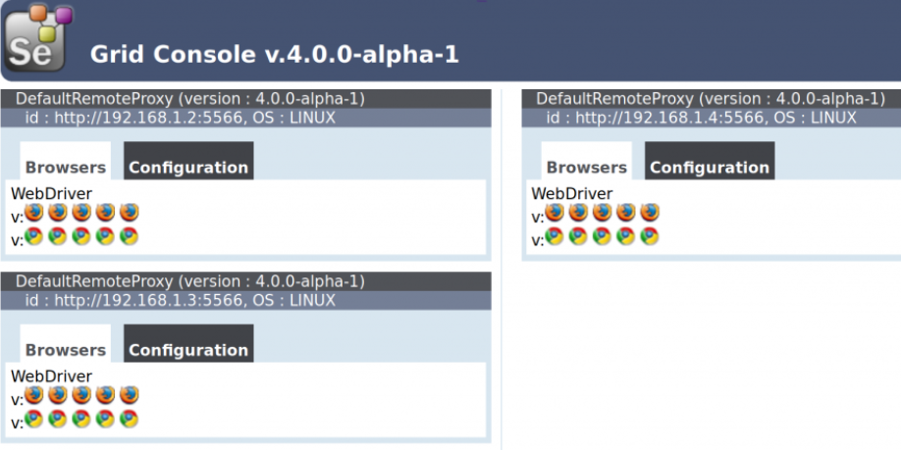
Selenium Grid

Slide 35
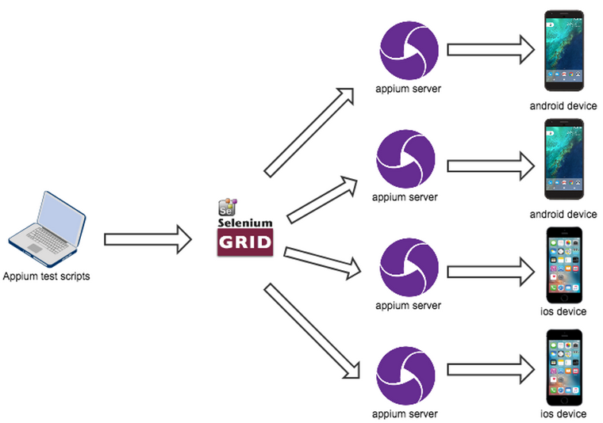
Selenium Grid (Mobile)

Slide 36
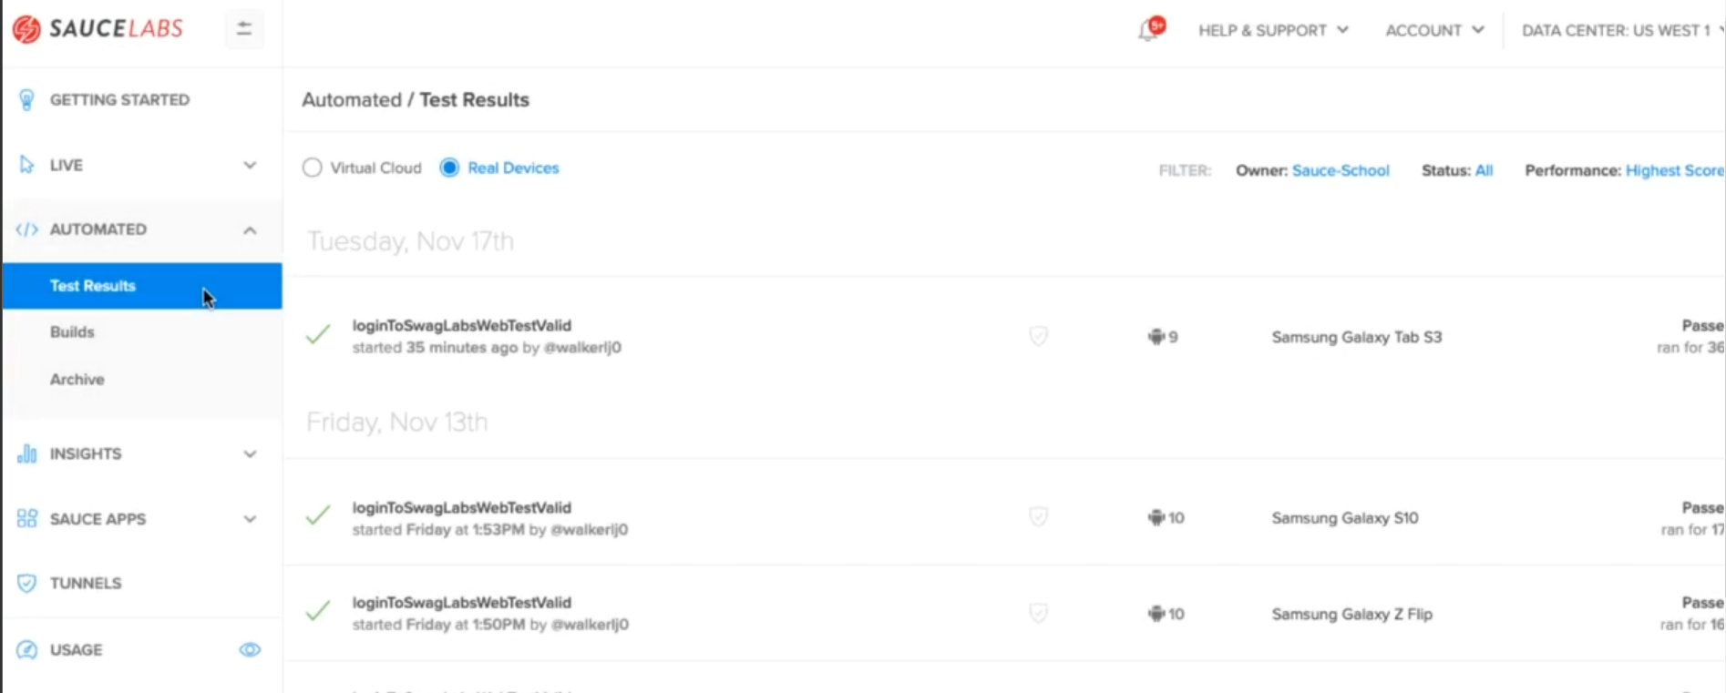
Cloud-Based Cross Browser Platform
Notes:
Demo running test on sauce labs

Slide 37
Visual Validation
Notes:
https://blog.percy.io/exciting-news-percy-is-now-part-of-browserstack-3b10e7500605

Slide 38
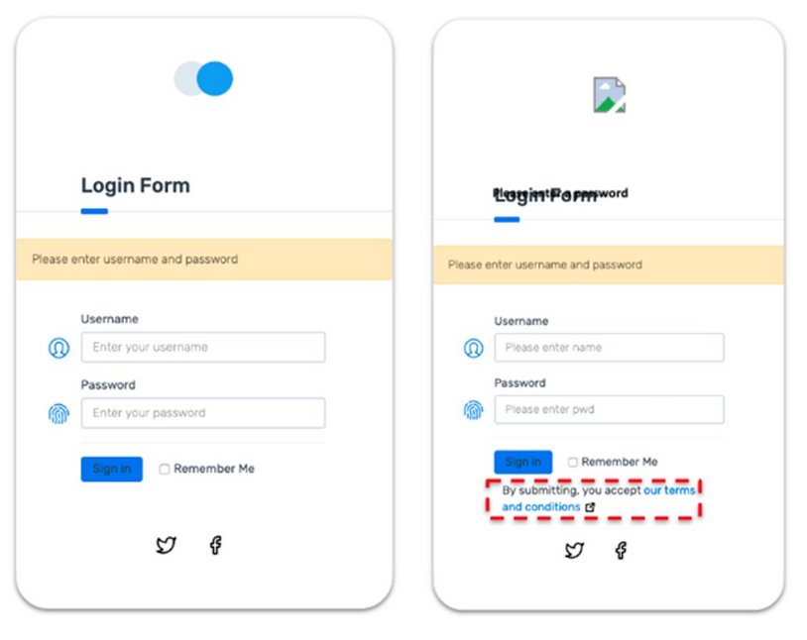
Visual Bugs

Slide 39
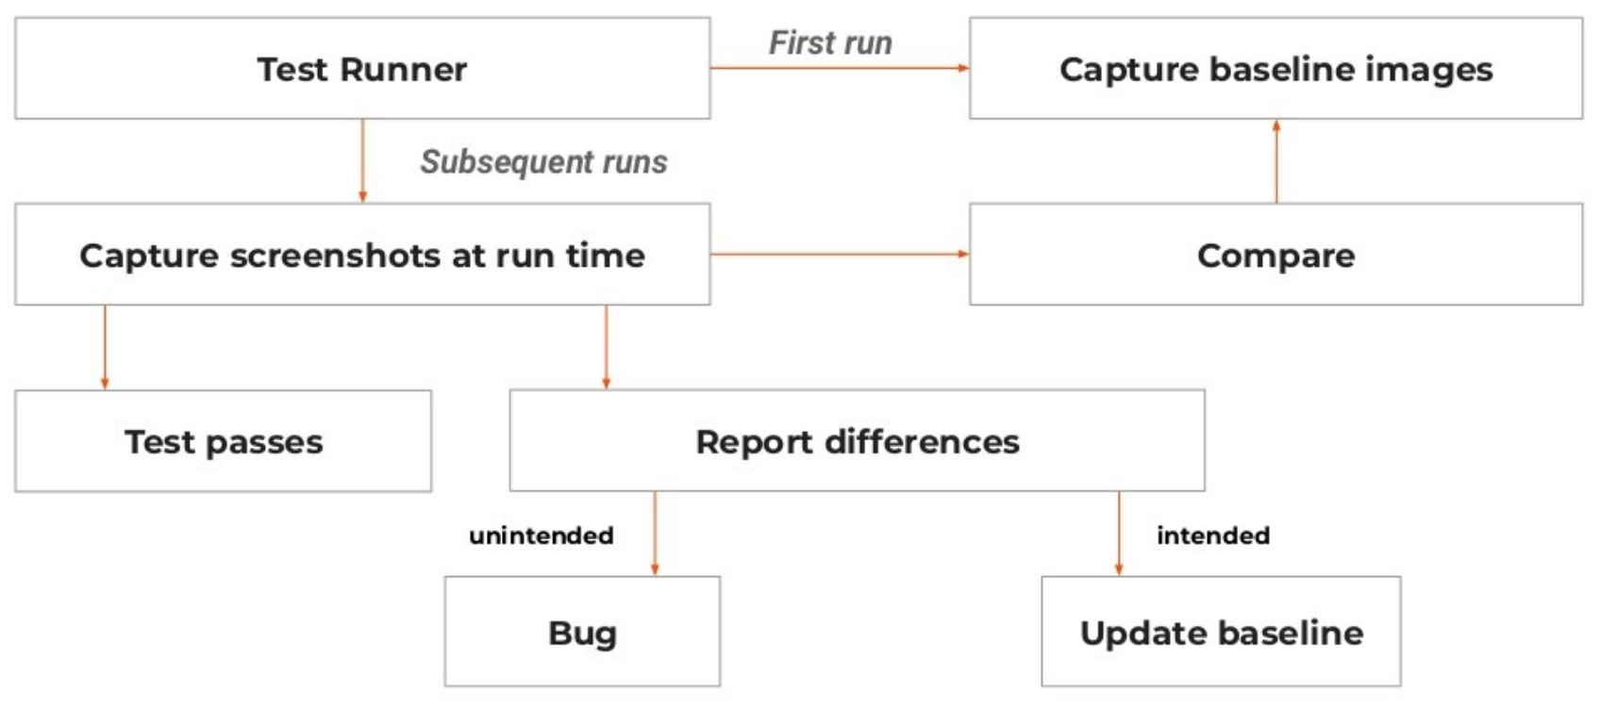
Visual Validation – How it works

Slide 40
Three Visual Test Technologies
Pixel Comparisons - take a snapshot of the screen and compare it with the pixels on a previous version of the page, or a version of the page from a different browser.
DOM Comparisons - capture the DOM of the page and compare it with the DOM capture of a previous version of the page.
Visual AI - Capture the screen image, break it into visual elements using AI, compare the visual elements with an older screen image broken into visual elements using AI and identify visible differences.
Notes:
https://www.infoq.com/articles/visual-ai-web-app-testing/
For visual validation, Pixel and DOM differences suffer from false positives, for which structural or rendering differences have no visible difference for users.

Slide 41
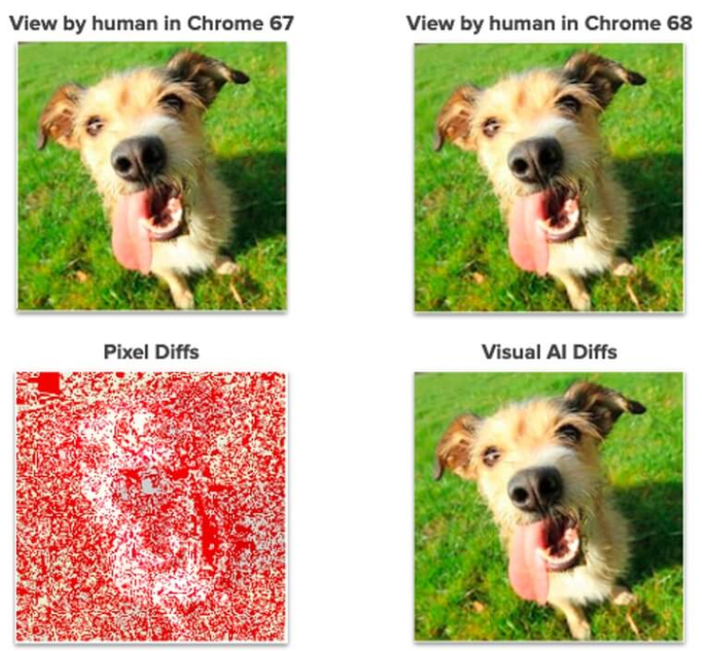
Pixel Comparisons vs Visual AI

Slide 42
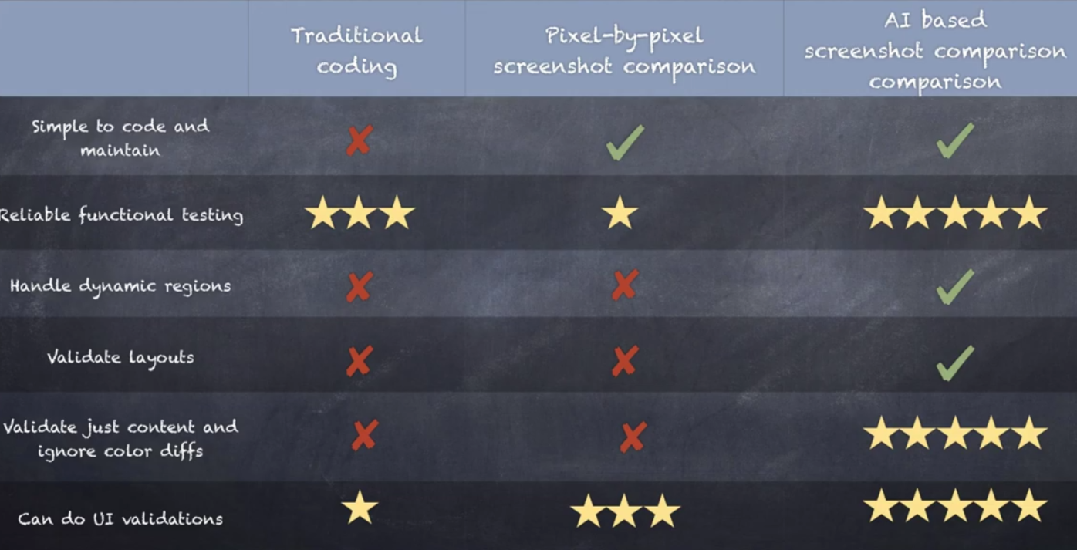

Slide 43
Available Tools
Open Source:
Cypress Visual Regression (pixel by pixel)
BackstopJS (DOM snapshot)
Paid:
Percy (pixel by pixel, BrowserStack)
Diffy (pixel by pixel + custom)
Screener (SauceLabs)
Applitools (AI)
Notes:
https://github.com/mjhea0/cypress-visual-regression
https://github.com/garris/BackstopJS
https://percy.io/
https://screener.io/
https://applitools.com/
https://diffy.website/diffy-vs-percy

Slide 44
UI Testing challenges

Slide 45
UI Testing challenges
High Initial Investment
Finding the Right Automation Tool
High Maintenance Due to Changing UI
Identify Test Cases Suitable for Automation
Stability
Cross browser, multiple device/platform testing
Notes:
Knowledge-heavy. Whoever is writing the scripts has to have technical knowledge and experience with the subject.
Time-consuming. One test can take 5 – 10+ minutes to run due to the processes. Load browser > execute tasks like a human > set up and tear down tests > data loading, and so on.
Maintenance. Modern apps have dynamic frontend UI. When a page loads and then the same page reloads, those element locators and links may change under the hood as to how they’re defined. The wait conditions can break the test. If a page takes longer to load, that returns a broken test.
Handling multiple errors. Complex scenarios mean huge data volumes. Sifting through this can be cumbersome.
Troubleshooting. Finding out what broke a test can be difficult depending on the frequency of issue and time spent fixing it.
Dynamic apps. Changes are always being made to web applications, as well as to apps themselves due to rapid/agile development. Tests must keep up from a maintenance perspective AND a results perspective.

Slide 46
UI Testing Best Practices
Do not rely ONLY on UI test automation
ALWAYS use test design patterns and principles
NEVER use Thread.sleep() unless there are specific test requirements
All tests should be small and independent
Take screenshots for failure investigation
Run tests in parallel
Notes:
https://www.blazemeter.com/blog/top-15-ui-test-automation-best-practices-you-should-follow

Slide 47
Reporting

Slide 48
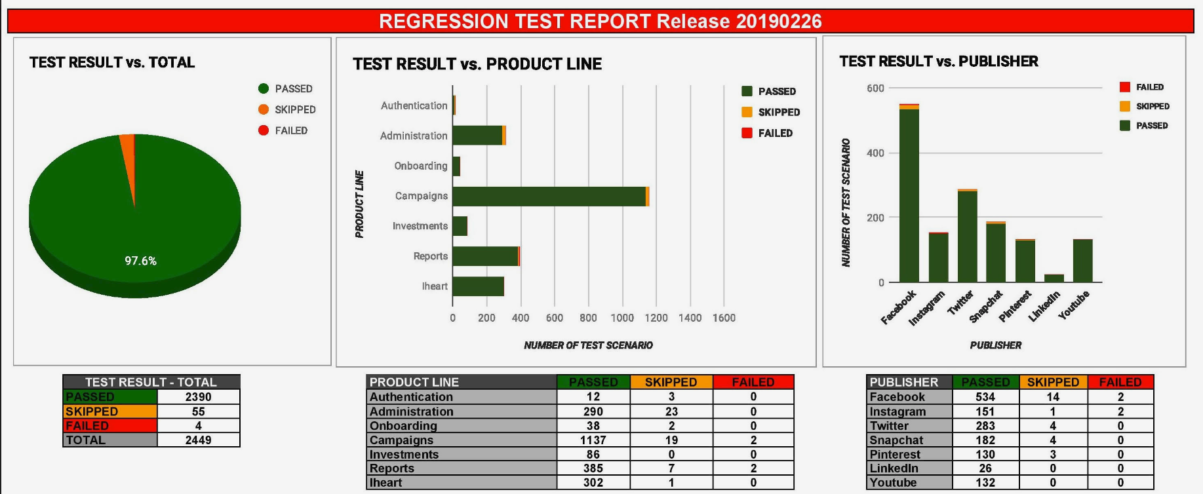
Customized Report

Slide 49
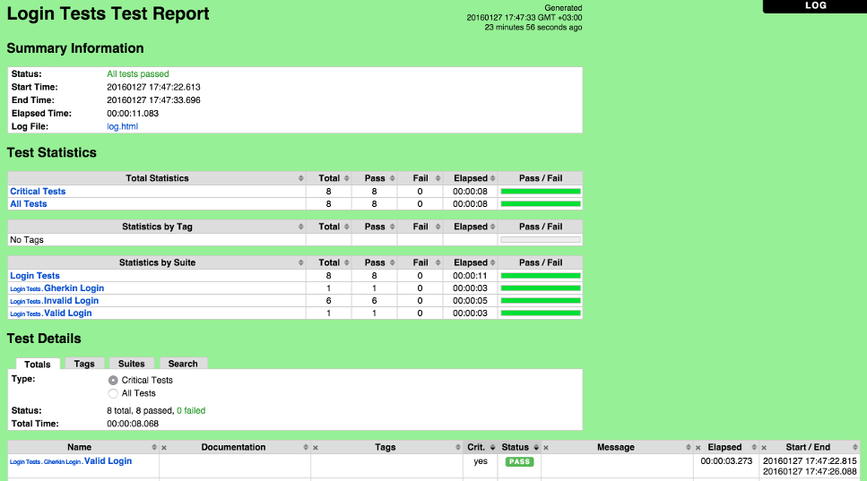
Report Generator Libraries
Robot Framework Report
Built-in library
Provide overview of all tests execution, console logs, failure screenshots

Slide 50
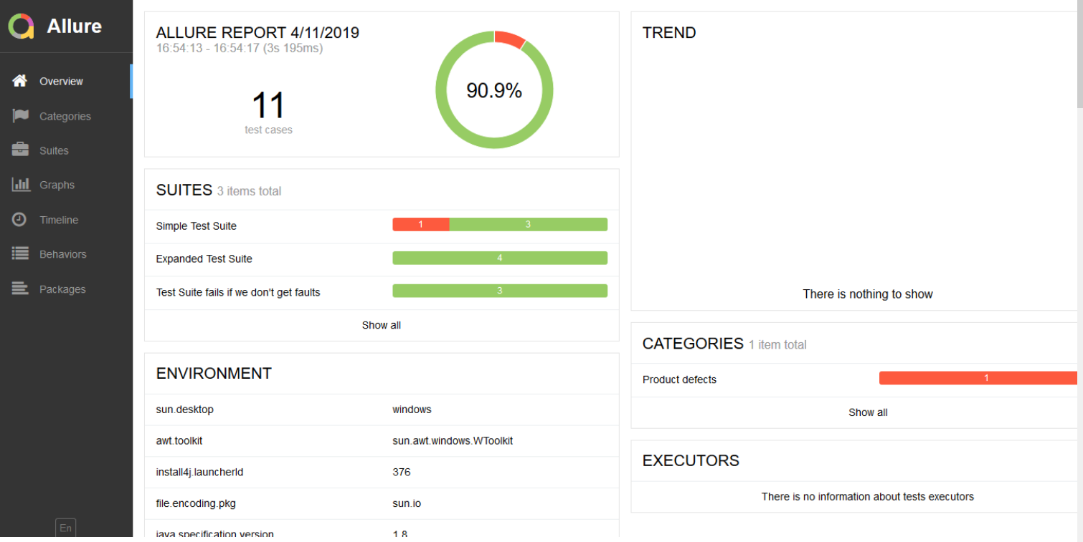
Allure Report
Notes:
https://docs.qameta.io/allure/

Slide 51
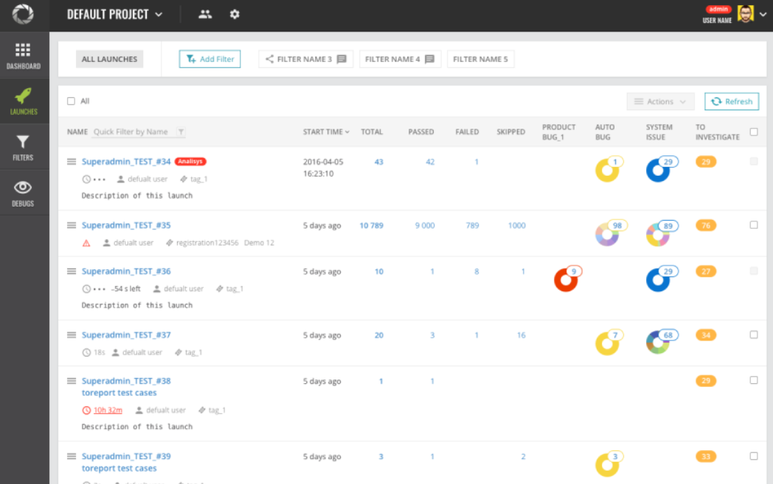
AI-powered ReportPortal
Notes:
https://reportportal.io/docs
https://dev-tester.com/how-to-gather-your-test-automation-results-with-reportportal

Slide 52

THANK YOU

